Slide 1
Introduction to Biostatistics
Nguyen Quang Vinh – Goto Aya

Slide 2
What & Why is Statistics?
+ Statistics, Modern society
+ Objectives → Statistics
Applying for Data analysis
+ Correct scene - Dummy tables
+ Right tests

Slide 3
What & Why is Statistics?

Slide 4
Statistics
Statistics: - science of data
        - study of uncertainty
Biostatistics: data from: Medicine, Biological sciences (business, education, psychology, agriculture, economics...)
Modern society:
  - Reading, Writing &
  - Statistical thinking: to make the strongest possible conclusions from limited amounts of data.

Slide 5
Objectives
(1) Organize & summarize data
(2) Reach inferences (sample → population)
Statistics:
Descriptive statistics → (1)
Inferential statistics → (2)

Slide 6
Descriptive statistics
Grouped data the frequency distribution
Measures of central tendency
Measures of dispersion (dispersion, variation, spread, scatter)
Measures of position
Exploratory data analysis (EDA)
Measures of shape of distribution: graphs, skewness, kurtosis

Slide 7
Inferential statistics drawing of inferences
Estimation
Hypothesis testing → reaching a decision
+ Parametric statistics
+ Non-parametric statistics << Distribution-free statistics
Modeling, Predicting

Slide 8
Descriptive statistics
GROUPED DATA THE FREQUENCY DISTRIBUTION
Tables
Class Limit | Frequency | Relative frequency | Cumulative Frequency | Cumulative Relative Frequency
...
...

Slide 9
Descriptive statistics
MEASURES OF CENTRAL TENDENCY
The Mean (arithmetic mean)
The Median (Md)
The Midrange (Mr)
Mode (Mo)

Slide 10
Descriptive statistics
MEASURES OF DISPERSION
(dispersion, variation, spread, scatter)
Range
Variance
Standard Deviation
Coefficient of Variance

Slide 11
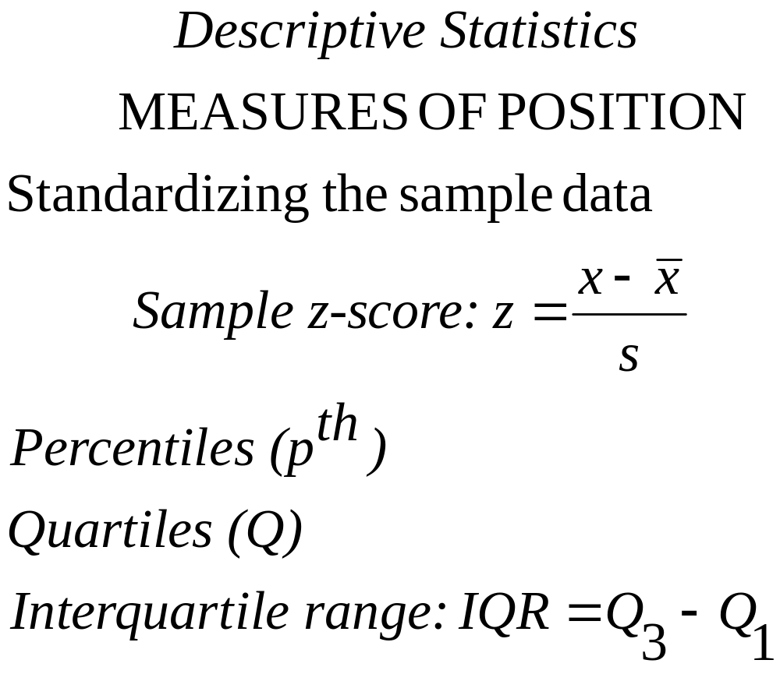

Slide 12
Descriptive statistics
Exploratory data analysis (EDA)
Stem & Leaf displays
Box-and-Whisker Plots (min, Q₁, Q₂, Q₃, max)

Slide 13
Descriptive statistics
MEASURES OF SHAPE OF DISTRIBUTION
Graphs
Frequency distribution
Relative frequency of occurrence → proportion of values
Nominal, Ordinal level
Bar chart
Pie chart
Interval, Ratio level
The histogram: frequency histogram & relative frequency histogram
Frequency polygon: midpoint of class interval
Pareto chart: bar chart with descending sorted frequency
Cumulative frequency
Cumulative relative frequency → OGIVE graph (Ojiv or Oh’-jive graph)

Slide 14
Descriptive statistics
MEASURES OF SHAPE OF DISTRIBUTION
Skewness, Kurtosis
Skewness (S_{k}), Pearsonian coefficient, is a measure of asymmetry of a distribution around its mean.
Kurtosis characterizes the relative peakedness or flatness of a distribution compared with the normal distribution.

Slide 15





Inferential statistics
Estimation

Slide 16

Inferential statistics
Hypothesis testing
→ reaching a decision

Slide 17
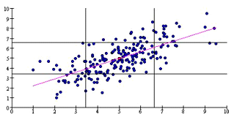
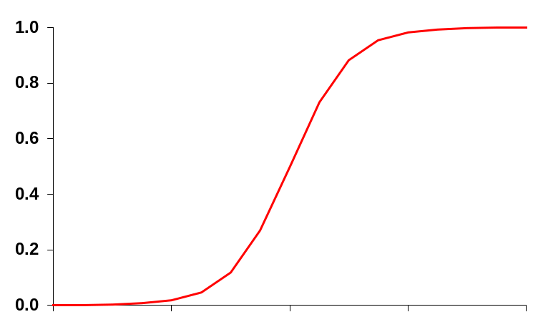
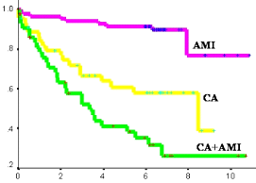
Inferential statistics
Modeling, Predicting

Slide 18
What statistical calculations cannot do
Choosing good sample
Choosing good variables
Measuring variables precisely

Slide 19
Goals for physicians
Understand the statistics portions of most articles in medical journals.
Avoid being bamboozled by statistical nonsense.
Do simple statistics calculations yourself.
Use a simple statistics computer program to analyze data.
Be able to refer to a more advanced statistics text or communicate with a statistical consultant (without an interpreter).
Notes:
Not being a number 1 “statistician” among physicians! But understanding...

Slide 20
Two problems:
Important differences are often obscured (biological variability and/or experimental imprecision)
Overgeneralize

Slide 21

How to overcome
Scientific & Clinical Judgment
Common sense
Leap of faith

Slide 22
Statistics encourage investigators to become
thoughtful &
independent problem solvers

Slide 23

Applying for Data analysis
Very important!
Have the authors set the scene correctly?
→ Dummy tables

Slide 24
Choosing a test for comparing the averages of 2 or more samples of scores of experiments with one treatment factor
Data | Between subjects (independent samples) | Within subjects (related samples)
 | 2 samples
Interval | Independent t-test | Paired t-test
Ordinal | Wilcoxon-Mann-Whitney test | Wilcoxon signed ranks test, Sign test
Nominal | Chi-square test | Mc Nemar test
 | > 2 samples
Interval | One way ANOVA | Repeated measured ANOVA
Ordinal | Kruskal-Wallis test | Friedman test
Nominal | Chi-square test | Cochran’s Q test (dichotomous data only)

Slide 25
Scheme for choosing one-sample test
Nominal | 2 categories | >2 categories
 | Binomial test | Chi-square test
Ordinal | Randomness | Distribution
 | Runs test | Kolmogorov-Smirnov test
Interval | Mean | Distribution
 | t-test | Kolmogorov-Smirnov test

Slide 26
Measures of association between 2 variables
Data | Statistic
Interval | Pearson Correlation (r)
Ordinal | Spearman’s Rho, Kendall’s tau-a, tau-b, tau-c
Nominal | Phi, Cramer V

Slide 27
Design | Data summary | Statistics & Tests
2 independent groups | Proportions Rank Ordered Mean Survival | Chi-square, Fisher-exact Mann-Whitney U Unpaired t-test Mantel-Haenzel, Log rank
2 related groups | Proportions Rank Ordered Mean | McNemar Chi-square Sign test Wilcoxon signed rank Paired t-test
More than 2 independent groups | Proportions Rank Ordered Mean Survival | Chi-square Kruskal-Wallis ANOVA Log rank
More than 2 related groups | Proportions Rank Ordered Mean | Cochran Q Friedman Repeated ANOVA
Study of Causation; one independent variable (univariate) | Proportion Mean | Relative Risk Odd Ratios Correlation coefficient
Study of Causation; more than one independent variable (Multivariate) | Proportion Mean | Discriminant Analysis Multiple Logistic Regression Log Linear Model Regression Analysis Multiple Classification Analysis

Slide 28
How to interpret statistical results
Example

Slide 29
Example
113 newborns, Male:Female = 50:63, were weighted (grams) as follow:
Male: 3500, 3700, 3400, 3400, 3400, 3100, 4100, 3600, 3600, 3400, 3800, 3100, 2400, 2800, 2600, 2100, 1800, 2700, 2400, 2400, 2200, 2600, 4600, 4400, 4400, 2100, 4300, 3000, 3300, 3100, 3400, 3300, 4100, 2300, 3000, 4400, 3100, 2900, 2400, 3500, 3400, 3400, 3100, 3600, 3400, 3100, 2800, 2800, 2600, 2100.
Female: 3900, 2800, 3300, 3000, 3200, 3600, 3400, 3300, 3300, 3300, 4200, 4500, 4200, 4100, 2400, 3100, 3500, 3100, 2800, 3500, 3800, 2300, 3200, 2300, 2400, 2200, 4400, 4100, 3700, 4400, 3900, 4100, 4300, 4100, 2900, 2500, 2200, 2400, 2300, 2500, 2200, 4100, 3700, 4000, 4000, 3800, 3800, 3300, 3000, 2900, 2000, 2800, 2300, 2400, 2100, 3700, 3400, 3900, 4100, 3600, 3800, 2400, 1800.

Slide 30
Questions
% of F ≠ 50%
Mean of weights ≠ 3000g

Slide 31
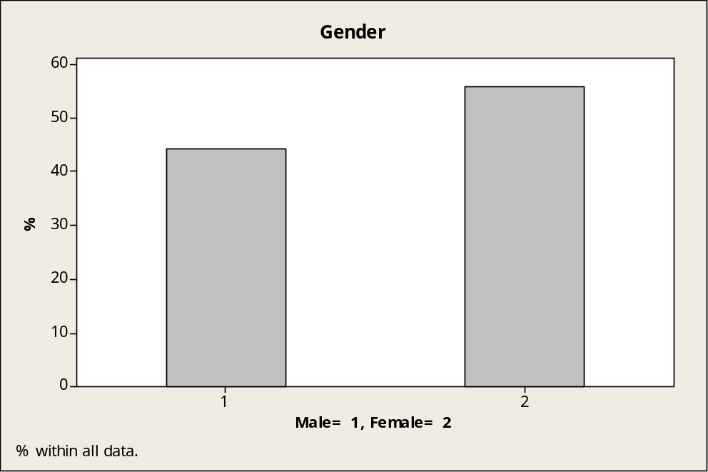
Descriptive statistics
n= 113
Gender: Female (n,%) 63 (0.56%)

Slide 32
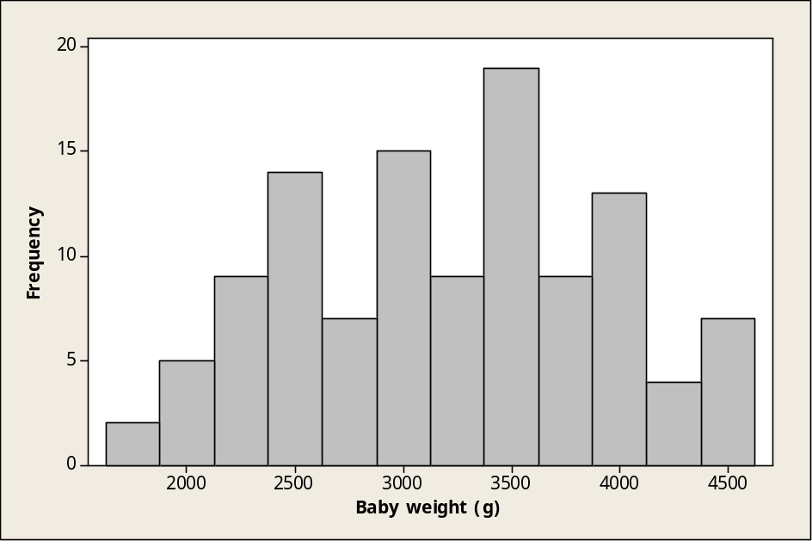
Descriptive statistics
n= 113
Weight:
  Mean: 3217.7g (S.D.= 0.499g)
  Median: 3300g (Min: 1800g, Max: 4600g)

Slide 33
Analytic statistics
Binomial test
Test of p = 0.5 vs. p not = 0.5
The results indicate that there is no statistically significant difference (p = 0.259).
  In other words, the proportion of females in this sample does not significantly differ from the hypothesized value of 50%.
 | f/n | Sample p | 95% CI | p-value
Female | 63/113 | 0.56 | 0.46-0.65 | 0.259

Slide 34
Analytic statistics
One sample t-test
Test of μ = 3000 vs. not = 3000
The mean of the variable weight 3217.70g, which is statistically significantly different from the test value of 3000g.
  Conclusion: this group of newborns has a significantly higher weight mean.
n= 113 | Mean | SD | SEM | 95% CI | t | p
Weight | 3217.70 | 711.42 | 66.92 | 3085.10-3350.30 | 3.25 | 0.002

Slide 35
References
Intuitive Biostatistics. Harvey Motulsky. Oxford University Press, 2010.
Business Statistics Textbook. Alan H. Kvanli, Robert J. Pavur, C. Stephen Guynes. University of North Texas, 2000.
Biostatistics: A Foundation for Analysis in the Health Sciences. Wayne W. Daniel. Georgia State University, 1991.

